Slide 1


Ansible
www.cognixia.com

Slide 2


Ansible
Ansible is a deployment automation tool which traditionally uses push approach to achieve its objectives, by managing all the servers through one single machine running the Ansible Configuration Management Tool
www.cognixia.com

Slide 3
Ansible Push Approach
Ansible clients do not have any agents installed on them, therefore there is no concept of polling with central server.
Ansible uses the Push approach instead. Still, ansible is flexible enough to let the user implement Pull architecture as well.
www.cognixia.com

Slide 4

Configuration Management Tools
Push approach does not require agents set up on individual nodes like pull does
Push based systems are completely Synchronous as you can see the changes made instantaneously and can fix the system if changes cause problems
Systems using pull architecture can scale
quite easily which is not the case with push
model
www.cognixia.com

Slide 5
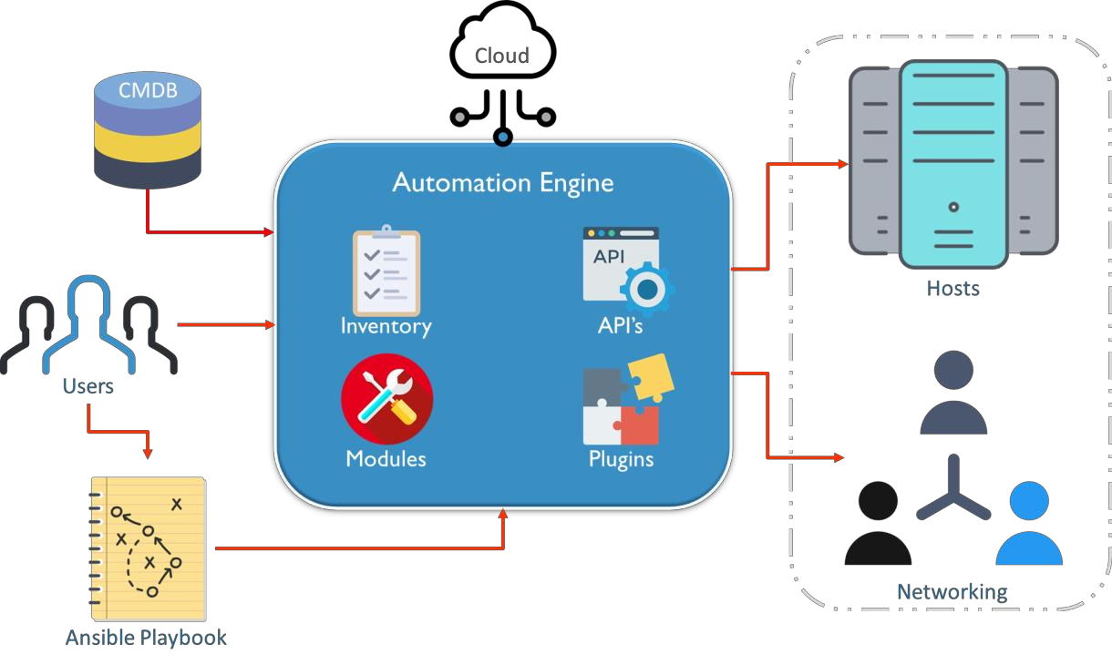
Ansible Architecture
Ansible uses playbooks to implement the desired configuration changes. The user directly interacts with the ansible automation engine and playbooks.
www.cognixia.com

Slide 6

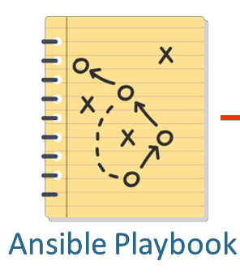
Ansible Architecture - Playbooks
Ansible uses playbooks to implement the changes desired by the users
•
Playbooks contain plays, plays have tasks and tasks call modules
•
Modules are the units which actually execute on the servers
•
www.cognixia.com

Slide 7

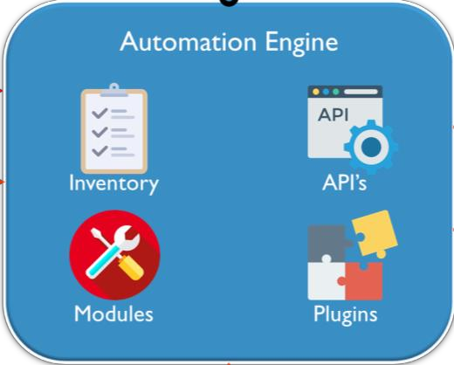
Ansible Architecture – Automation Engine
Ansible uses playbooks to implement the changes desired by the users
•
Playbooks contain plays, plays have tasks and tasks call modules
•
Modules are the units which actually execute on the servers
•
www.cognixia.com

Slide 8
Ansible Architecture – Automation Engine
The API’s in ansible are there to support services like cloud and CLI
•
Eg. Python API is used for Command Line Interface
•
www.cognixia.com

Slide 9
Ansible Architecture – Automation Engine
Plugins provide extra
functionality to ansible
•
Eg. Action plugin lets you perform tasks on your ansible machine before you execute a playbook
•
www.cognixia.com

Slide 10

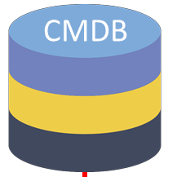
Ansible Architecture – CMDB
The configuration management keeps a record of all the configuration changes made in the system
This database could be kept on the cloud platform or on the physical server as well
www.cognixia.com

Slide 11


Ansible Architecture – Cloud
Ansible has a huge support for
numerous cloud applications
•
These cloud applications can seamlessly be integrated with ansible
•
Ansible makes provisioning cloud infrastructures easy
•
www.cognixia.com

Slide 12
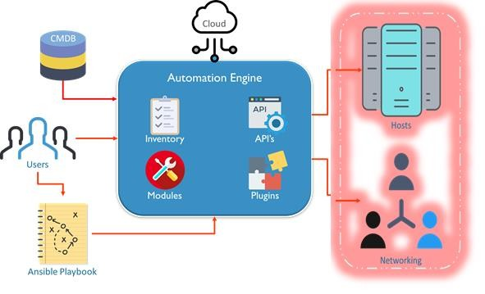
Ansible Architecture – Hosts & Networks
The hosts are connected to the ansible system via secure SSH connection (though other encryption technologies can also be used).
Different networks can be managed together giving each network separate access rights.
www.cognixia.com

Slide 13
Exercise 1: Ansible Installation
Ansible requires a secure transport to nodes, hence openssh(linux/unix) or winrm(windows) must be setup on each machine
Latest python libraries must be installed on the ansible machine
www.cognixia.com

Slide 14
Ansible Inventory
Ansible’s inventory lists all the platforms you want to automate across. Ansible can at a single instance work on multiple hosts in the infrastructure. It is also possible to have multiple inventory files at the same time.
www.cognixia.com

Slide 15
Inventory Hosts & Groups
The host inventory file can contain host names either individually or in groups
Host Groups can be created by giving a group name within square
brackets
Group members can then be listed under, till there is a line brake
www.cognixia.com

Slide 16
Ansible Modules
Modules are units which actually get the work done in ansible. Ansible’s module are used to control system resources, like services, packages, execute system commands, or files
There are over 450 in-built modules in ansible
www.cognixia.com

Slide 17
Ansible Modules
Modules abstract system tasks, like dealing with packages or handling files from
ansible servers
Users can choose to either use a module from ansible’s in-built library or create their own custom modules
Almost all of the modules support taking arguments in key-value format
www.cognixia.com

Slide 18
Exercise 2: Ansible Modules
Run ad-hoc commands to use Ansible modules
www.cognixia.com

Slide 19
Ansible Playbooks
Playbooks are the access point to ansible provisioning
It’s the Ansible’s way of deploying and configuring different remote servers and environments
It is written in YAML(Yet Another Mark-up Language)
On an advanced level playbooks can be used to
Handle multi-tier rollouts
Load balancing tasks for the servers
www.cognixia.com

Slide 20
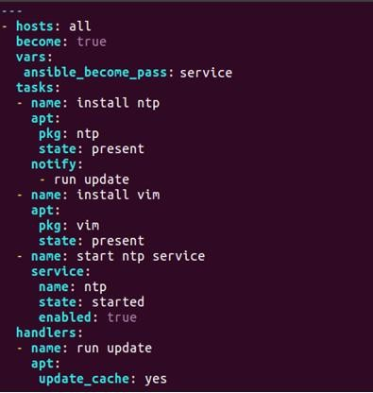
Ansible Playbook Structure
Besides the basic structure of a YAML file there are a few things to be kept in mind before writing a playbook
www.cognixia.com

Slide 21

Ansible Playbook Structure
All playbooks(YAML files) start with three hyphens in the top left corner
www.cognixia.com

Slide 22

Ansible Playbook Structure : Hosts
Each play in a playbook starts with the host(s) the play is supposed to be executed on.
Hosts also defines the start of the play
There may be multiple plays in a single playbook
www.cognixia.com

Slide 23

Ansible Playbook Structure : Become
Become here is used to become a different user than the one logged into the remote machine
This is mainly done for Privilege Escalation
For example gaining su access
www.cognixia.com

Slide 24

Ansible Playbook Structure : Vars
Variables are defined by using the vars keyword
Playbooks are executed line by line hence variables need to be defined before their use in playbooks
www.cognixia.com

Slide 25

Ansible Playbook Structure : Tasks
All the tasks that are to be executed on remote systems are defined in under the tasks section
A single play can consist multiple tasks
Tasks are executed in order
www.cognixia.com

Slide 26


Ansible Playbook Structure : Handlers
Tasks may contain notify actions which are triggered at the end of a block
Notify triggers are call upon tasks in the handler section
Handlers are tasks which are executed only once for every play
www.cognixia.com

Slide 27
Exercise 3: Write a Playbook
Write Ansible Playbook to install Apache
www.cognixia.com

Slide 28
Exercise 4: Write a Playbook Using Variables
Write Ansible Playbook using variables
www.cognixia.com

Slide 29
Ansible Roles
Overtime working with ansible a user may create hundreds of playbooks, variables, templates, defaults etc. Roles allow users to group this logic into an organized manner making reusability and sharing of ansible structure easier
www.cognixia.com

Slide 30
Ansible Roles
Overtime working with ansible a user may create hundreds of playbooks, variables, templates, defaults etc.
Roles allow users to group this logic into an organized manner making reusability and sharing of ansible structure easier.
www.cognixia.com

Slide 31
Ansible Roles
Roles uses directories to structure and group all the playbooks, variables, templates, tasks, handlers, files, and defaults.
This collected logic can be grouped in any way the user wants, for
example you can group server specific roles together
These roles can then be used inside playbooks and even as in-line commands
www.cognixia.com

Slide 32
Ansible Galaxy
Galaxy provides pre-packaged units of work known to Ansible as roles
Roles can be dropped into Ansible PlayBooks and immediately put to work
To create a Ansible roles, use ansible-galaxy command which has the templates to create it
This will create it under the default directory /etc/ansible/roles and do the
modifications else we need to create each directories and files manually
# ansible-galaxy init /etc/ansible/roles/apache –offline
where, ansible-glaxy is the command to create the roles using the templates
init is to initiliaze the role
apache is the name of role
offline - create offline mode rather than getting from online repository
www.cognixia.com

Slide 33
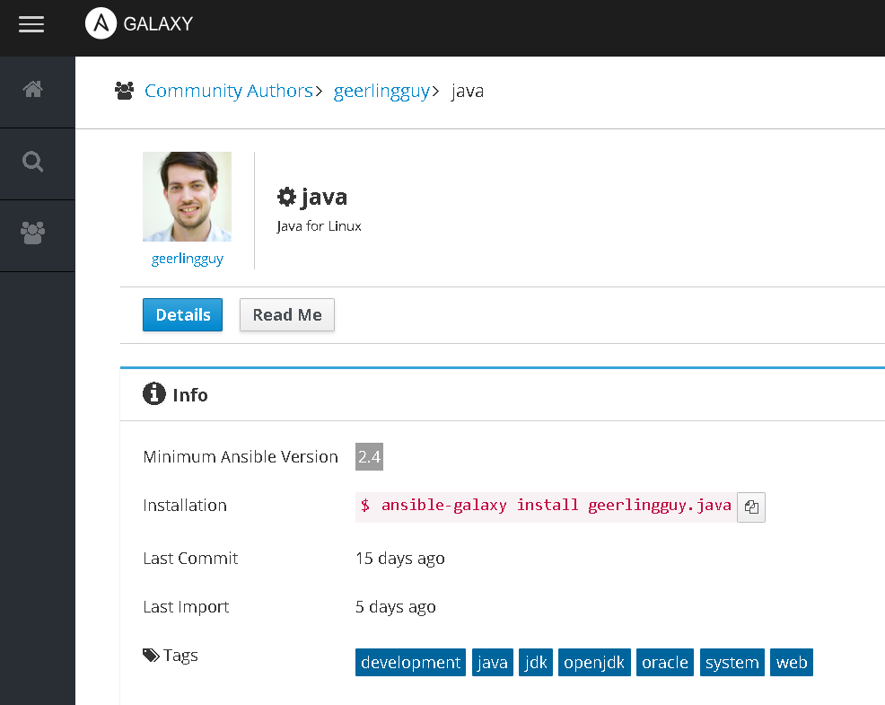
Ansible Galaxy
You can also download Ansible roles from https://galaxy.ansible.com/
www.cognixia.com

Slide 34
Exercise 5 : Ansible Roles
Write Ansible role to install Apache
www.cognixia.com

Slide 35
Ansible Tags
If you have a large playbook it may become useful to be able to run a specific part of the configuration without running the whole playbook
Both plays and tasks support a “tags:” attribute for this reason
You can ONLY filter tasks based on tags from the command line with --tags or -
-skip-tags
Adding “tags:” in any part of a play (including roles) adds those tags to the
contained tasks
www.cognixia.com

Slide 36
Ansible Tags
If you wanted to just run the
“configuration” and “packages” part of a very long playbook, you could do this:
tasks:
yum:
name: "{{ item }}"
state: installed loop:
httpd
memcached tags:
packages
ansible-playbook example.yml -- tags "configuration,packages“
On the other hand, if you want to run a playbook without certain tasks, you could do this:
- template:
src: templates/src.j2
dest: /etc/foo.conf tags:
- configuration
ansible-playbook example.yml -- skip-tags "notification"
www.cognixia.com

Slide 37
Py YAML
PyYAML is a YAML parser and emitter for Python
PyYAML features
a complete YAML 1.1 parser
The parsing algorithm is simple enough to be a reference for YAML
parser implementors
Unicode support including UTF-8/UTF-16 input/output and *
low-level event-based parser and emitter API (like SAX)
high-level API for serializing and deserializing native Python objects
support for all types from the YAML types repository.
A simple extension API is provided
both pure-Python and fast LibYAML-based parsers and emitters
relatively sensible error messages
www.cognixia.com

Slide 38
Py YAML Requirement
PyYAML requires Python 2.7 or Python 3.4+
The current stable release of PyYAML: 3.13
It can be downloaded from
https://pyyaml.org/wiki/PyYAML
www.cognixia.com

Slide 39
THANK YOU
www.cognixia.com

